Slide 1
Coastal Enhancement Guidance Training Toolkit
Notes:
Hello and welcome to this NRW training toolkit on Ecological Enhancement of Coastal Structures.

Slide 2
Table of Contents
Click to select section
Part 1 – Context
5 Minutes
Part 2 – Consenting and Delivery
5 Minutes
Part 3 – Stepped Approach
10 Minutes
Part 4 – Case Studies
10 Minutes
Click Icon to
Return
Notes:
The toolkit is split into 4 parts – navigate to the desired section by clicking on the section headings; click the return icon at the bottom right to return to this menu.
Part 1 sets the context of ecological enhancement including the main drivers and objectives of the current guidance note.
Part 2 addresses issues related to consenting and delivery
Part 3 describes a stepped approach to implementation. This was designed to support users through a logical process but is not a prescriptive rule book
Part 4 contains several case studies and examples
I will now pass over to my colleagues to take you through the training toolkit.

Slide 3
Coastal Enhancement Guidance Training Toolbox
Part 1/4 - Context
(5 mins)
Notes:
Part 1 of the training toolbox will look to provide the context of the coastal enhancements guidance note looking at the purpose of the document, the key drivers and the assets associated

Slide 4
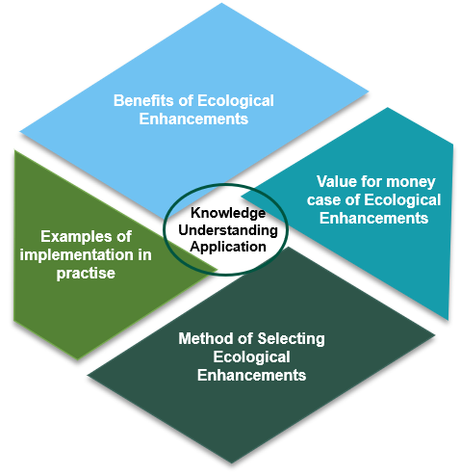
Guidance Note
Purpose of the Guidance Note
Key Drivers
Environment (Wales) Act 2016
Well-Being of Future Generations Act 2015
Welsh National Marine Plan: Welsh Government, 2019
NRW Marine Area Statement
National Strategy for FCERM
Notes:
One objective of coastal eco-engineering is to enhance marine biodiversity to comply with legislative requirements and to support policy targets to reverse the loss of marine biodiversity (key drivers include the Environment Act 2016 and the Welsh National Marine Plan 2019 listed on the left)
Another objective is to act as offsetting for impacts derived from project delivery as well as to provide enhancement following the delivery of coastal infrastructure through the management of assets.
The current guidance note focuses on ecological enhancements of existing and new infrastructure and nature based solutions such as beach nourishment or creation of intertidal saltmarshes are not considered here. Further information on these and other nature based solutions and references can be found in other NRW resources.
The diagram on the right highlights 4 main areas that are addressed is more detail in the Guidance Note:
Firstly Benefits of using ecological enhancements
Examples of implementation, mostly focused on the UK and using UK publications
The guidance note provides a stepped approach is provided to help users get from a starting point which can be a broad objective to actual implementation. This is not meant to be a prescriptive method, but rather a helpful resource to structure the process.
Lastly value for money case. Information to quantify the benefits of biodiversity is still at the initial steps, however the guidance note aims to provide some indicative information on this topic

Slide 5
What are ecological enhancements?
Ecological Enhancements
Marine Biodiversity
Environment (Wales) Act 2016
Priority Marine Habitats
Littoral Sediment Habitats:
Coastal saltmarsh.
Intertidal mudflats.
Seagrass beds.
Sheltered muddy gravels.
Peat and clay exposures.
Littoral Rock Habitats:
Intertidal boulder communities.
Sabellaria alveolata (honeycomb worm) reefs.
Estuarine rocky habitats.
Priority Marine Species
Benefit from enhancements:
Native oyster
Plaice
Sole
Stalked Jellyfish
Peacocks’ tail algae
Outside area of influence of coastal enhancements:
Cetaceans
Marine turtles
Sharks and rays
Notes:
Ecological enhancements are artificial structures or structural modifications which support and encourage the development of new biodiverse habitats. Ecoengineering enhancements can be incorporated into new build structures but also existing structures as part of remedial works, or retrofitting. They can be applied to an entire coastal scheme, to a discrete section, or to enhance a niche habitat.
Marine biodiversity in the context of this report reflects the full breadth of intertidal fauna and flora. The Environment (Wales) Act 2016 lists habitats and species of principal importance for the purpose of maintaining and enhancing biodiversity in Wales:
The table on the right lists some of the priority habitats and marine species outlined in the Environment (Wales) Act 2016.
These include Littoral Sediment Habitats such as Coastal saltmarsh and Littoral Rock Habitats such as Intertidal boulder communities.
The Priority Marine Species which can benefit from ecological enhancements of coastal structures include the native oyster and although not directly within the area of influence of coastal enhancements, other species such as cetaceans may benefit indirectly.

Slide 6
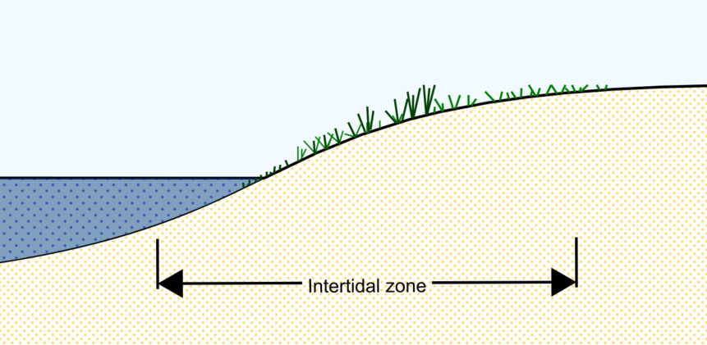
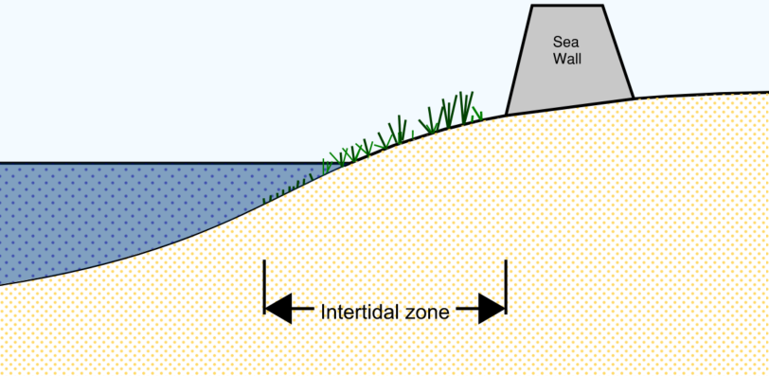
Why the need for change?
Wales By 2050
Typical Hard Engineering Assets
 |  | 1.34°C average summer temperature rise
 |  | 5% Winter Precipitation
 |  | 16% Summer Precipitation
 |  | 19cm Sea level Rise North Wales
 |  | 22cm Mid Wales
 |  | 24cm South Wales
Smooth untextured surface – More difficult for organisms to attach to
Coastal Hardening – Lack of shoreline complexity leading to deficit in habitat types
Coastal Squeeze
Coastal squeeze - where retreating habitats are blocked by hard engineered structures, amplified by sea level rise
Homogenous Shape – Lacks variety of microhabitats that support biodiversity
Notes:
Why the need for change?
Due to climate change, by 2050 Wales is expected to see an 1.34°C in its annual summer temperature and a 16% decrease in summer precipitation.
These significant changes can have adverse effects on marine ecosystems. Sea level rise and the hard engineering designed to protect assets can lead to Coastal squeeze and reduces the size of the intertidal zone.
Hard engineering structures typically designed for flood protection and erosion control have historically have lacked driver to promote biological diversity, Issues with typical hard engineering assets:
Smooth untextured surface, made from quarried rock or synthetic materials (concrete/ plastic) - different surface properties than natural coastal rock, therefore local organisms struggle to attach.
Coastal Hardening from the use of hard materials such as Concrete or Granite, weathers at a slower rate. The lack of complexity of the shoreline can lower the biodiversity
They also tend to have homogenous shapes and lack the variety of microhabitats that are known to be important for supporting biodiversity in natural reef habitats.
Coastal squeeze where retreating habitats are blocked by hard engineered structures, amplified by sea level rise

Slide 7
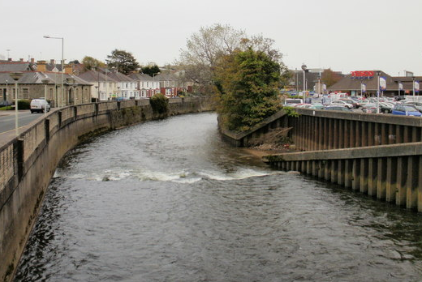
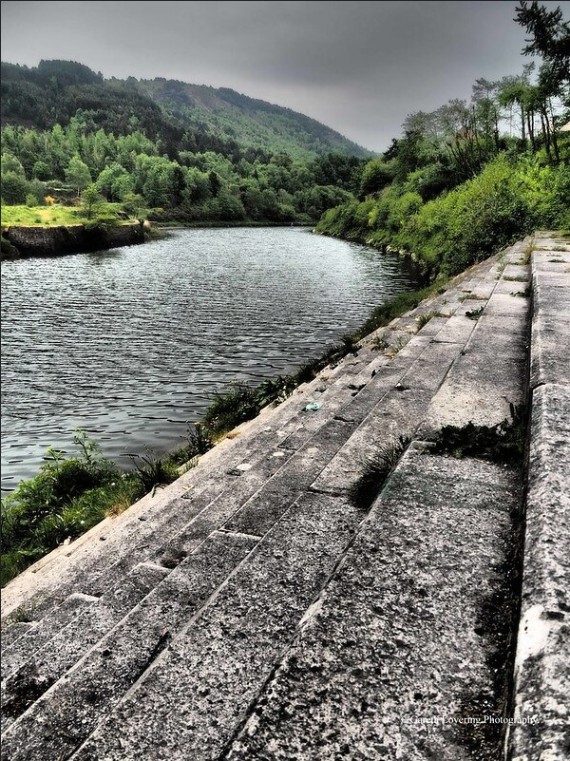
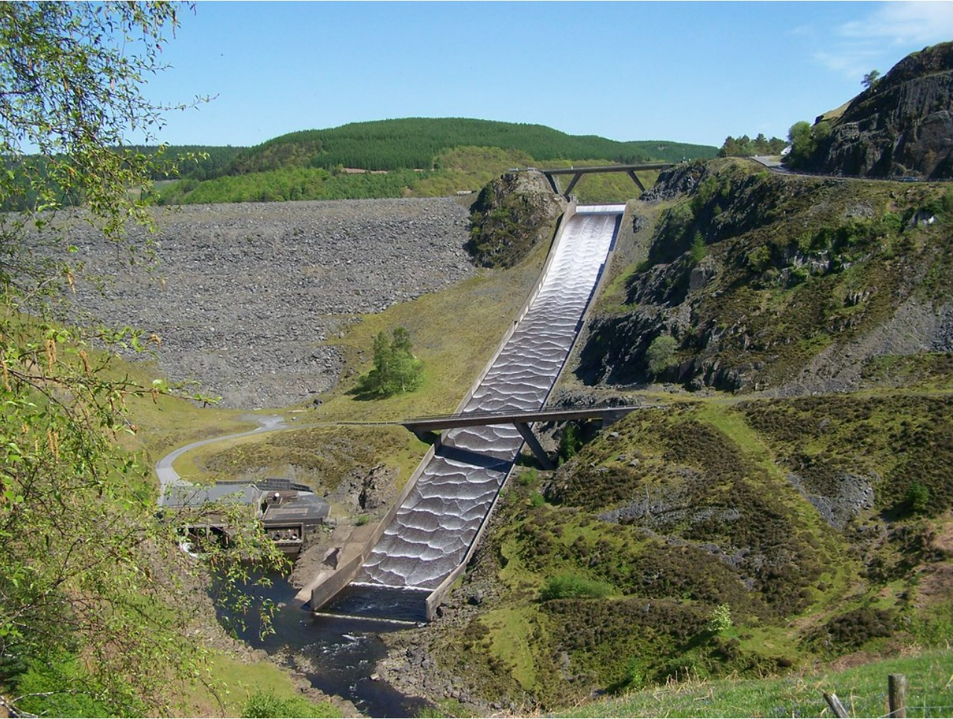
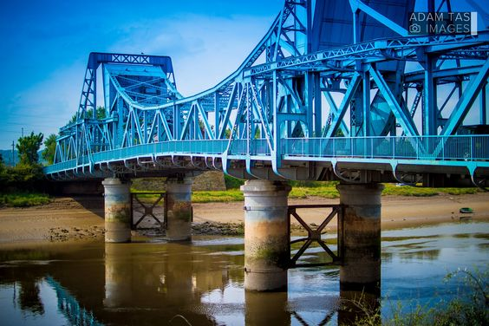
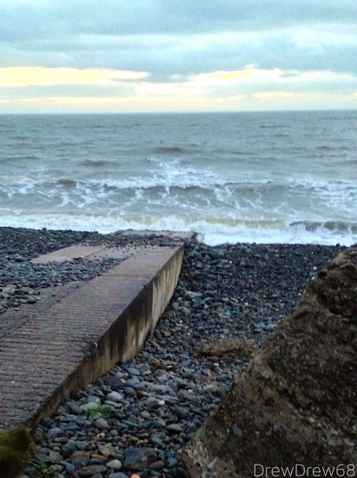
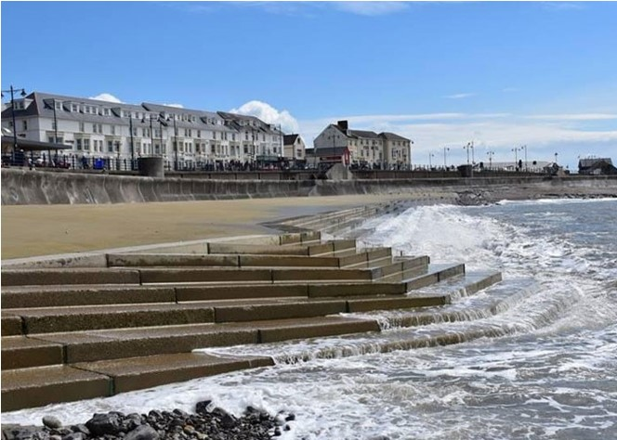
Types of assets/structures
Hard Engineering Assets
Open Channels (Tidal)
Embankments
Spillways
Bridge Abutments
Ramps and Slipways
Steps and Terraced revetments
Notes:
Examples of hard engineering assets in the coastal environment
Open Channels (tidal)
Embankments - including concrete faced, gabions, rock armour and riprap engineered embankments
Spillways
Bridge abutments
Ramps and Slipways
Steps and walls

Slide 8
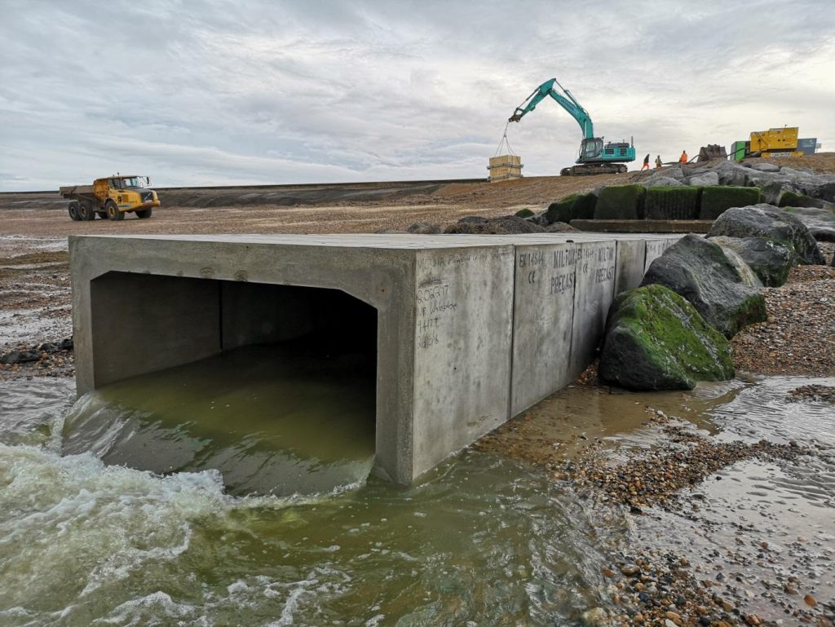
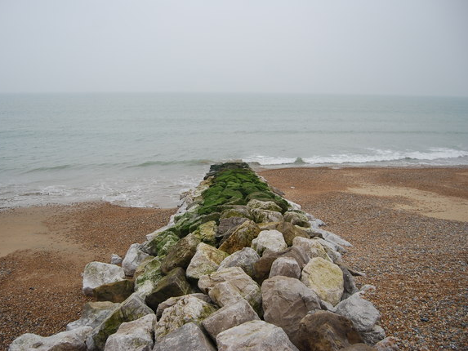
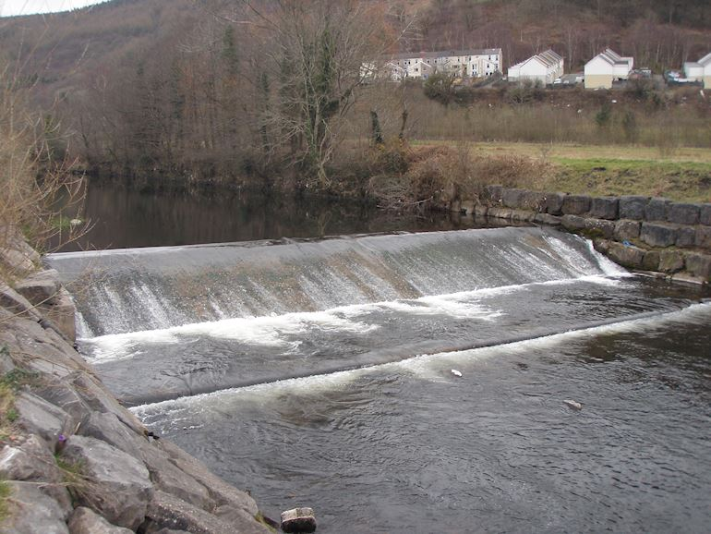
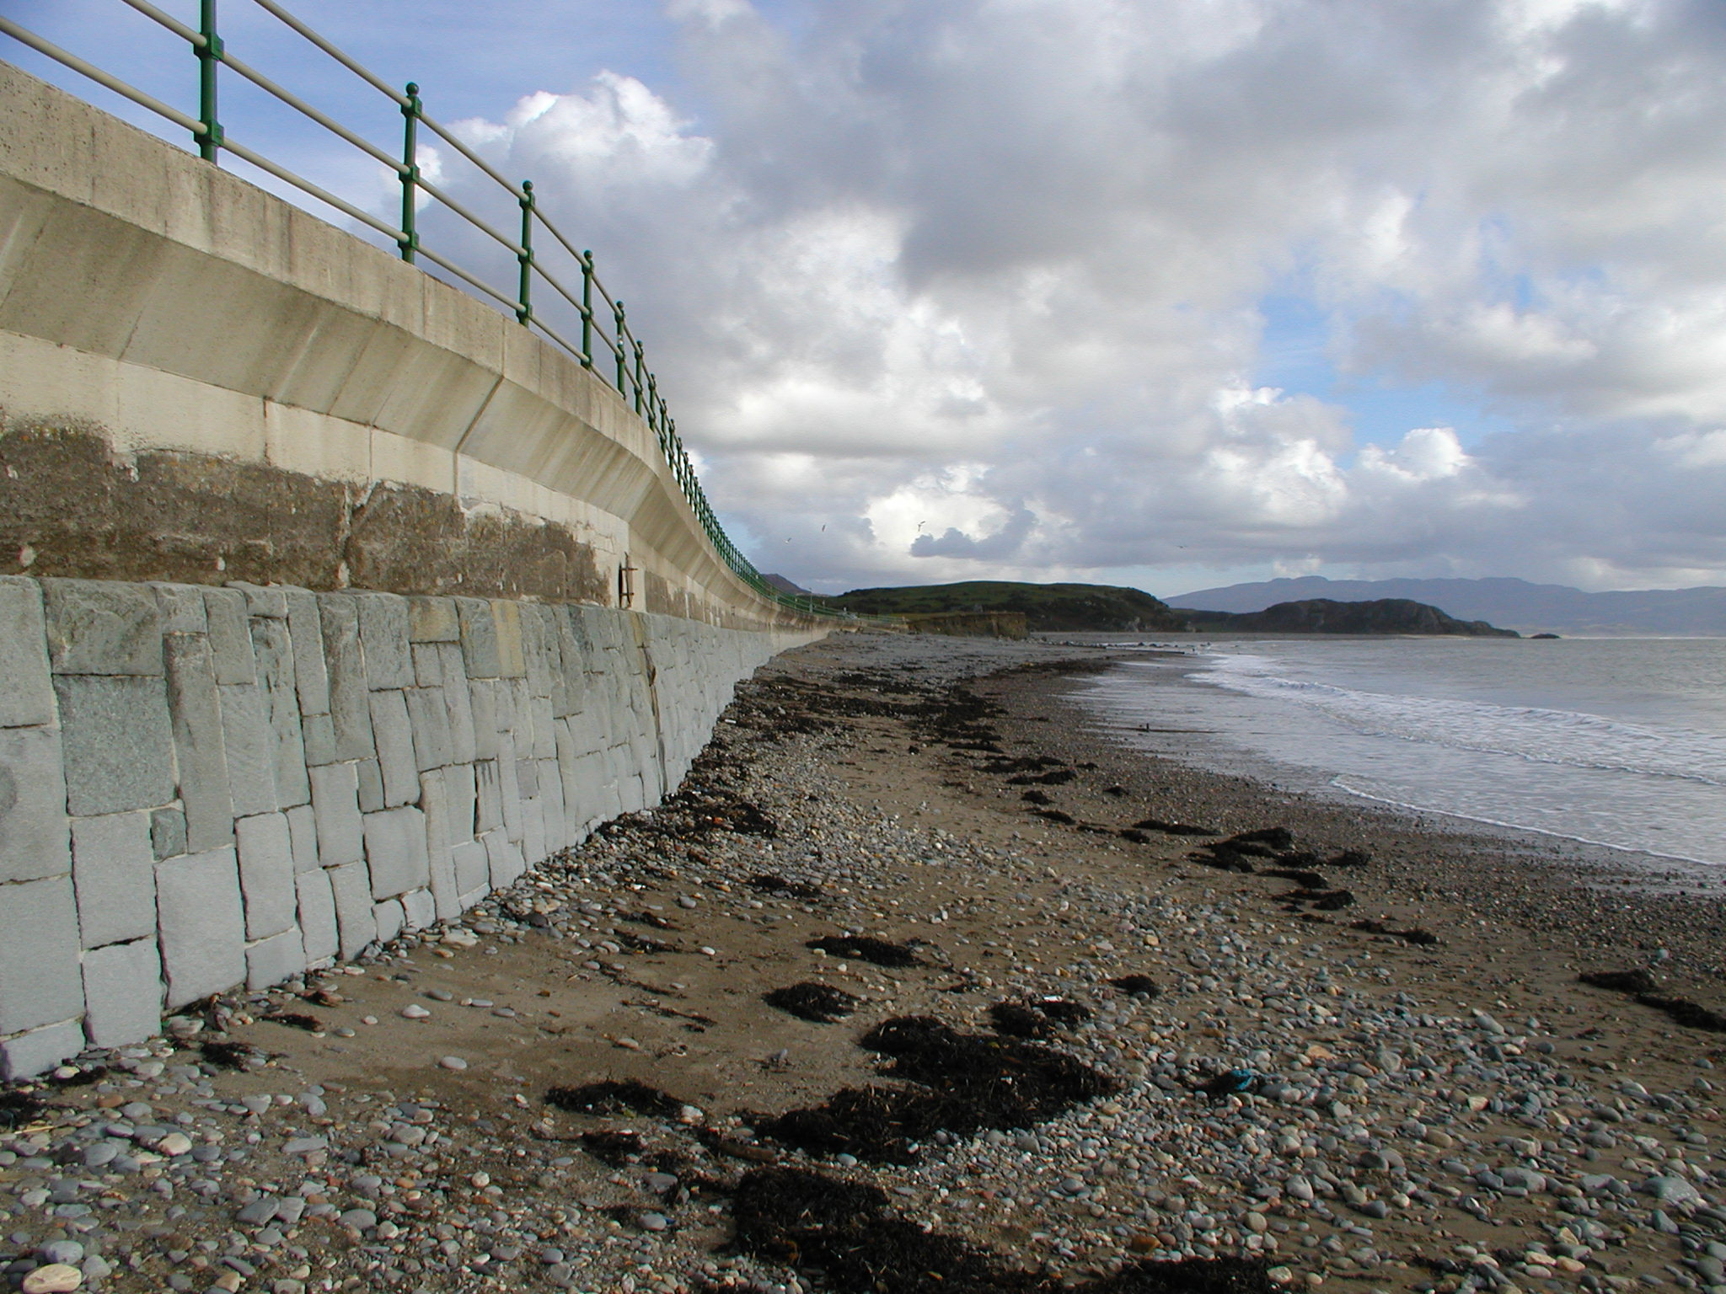
Types of assets/structures
Hard Engineering Assets
New Structures
For assets that need replacing Eco Enhancements can be embedded within the design of the new structure from the outset
Outfalls
Rock Groynes
Ageing Assets
For Ageing assets that need modification, Introduction of Eco Enhancements through remedial, refurbishment and upgrade works
Weir
Walls
Notes:
Examples of hard engineering assets in the coastal environment (cont.)
Outfalls
Rock Groynes - including rock armour, riprap and concrete groynes. Rock and concrete armour revetments and breakwaters can also be included here.
Walls - including concrete and masonry walls
Weirs
Ageing assets present an opportunity for the introduction of ecological enhancements as part of remedial, refurbishment and upgrade works, whether these be modifications to or replacement of existing assets.
Where an aged asset is to be replaced with a new structure, ecological enhancements can be embedded within the design of the new structure from the outset.

Slide 9
Coastal Enhancement Guidance Training Toolbox
Part 2/4 – Consenting and Delivery
(5 mins)
Notes:
The next part focuses on consenting and delivery often associated with ecological enhancements

Slide 10
Consenting & Licensing
Majority of Projects
Baseline Data
Desk study to identify the constraints/ opportunities and inform the likely consents, licences and permits
Marine Licensing
Deposits or removals below Mean High Water Springs require a marine licence
Water Framework Directive (WFD) assessment
Applications for a marine licence will need to be supported by a WFD Screening Assessment
Site Specific
Town and Country Planning
Requirements for planning permission extends to the Mean Low Water Springs (MLWS) mark requiring an application for planning permission prior to the delivery of certain proposals.
Habitats Regulations Assessment (HRA)
necessary where works are within or may affect the National Site Network (previously European Sites)
Historic Environment
Scheduled Monuments, Listed Buildings or Structures within Conservation Zone appropriate consent would be required to make any change that may affect their special interest.
European Protected Species
An ecological desk study (including Aderyn biodiversity records search) and ecological advice should be sought on the likely presence of EPS at the deployment site
Notes:
Regarding consenting and licensing, for the bulk of the interventions that are addressed in the Guidance Note, the key consenting activity is related to deposits or removal activity in the marine environment, so anything below mean high water springs triggers marine licensing.
On top of that, a lot of the Welsh coastline is protected, so it might trigger additional environmental surveys like Water Framework Directive assessment. Another usually important one is habitat regulations assessment where developments are taking place within international sites, such as special areas of conservation, special protection areas and ramsar sites.
Additionally, in the coastal zone and particularly intertidal zone there's a transition and there is duplicate processes because we need to consider marine licensing but also Town and Country Planning because the planning considerations will relate to areas down to mean low water springs.

Slide 11
Justification Assessment
Value Analysis
Wider Environmental benefits
maintenance and delivery of ecosystem services, supporting environmental targets and drivers
Economic
Job creation, business opportunity
Resilience
Reducing flood risks. Potential to limit weathering and reduce wave energy.
Ecological Value
Based on Potential habitat creation
Enhance cultural services (tourism)
Enhancements are often perceived as visually appealing
Increase Public Interest
Could lead to greater support during planning proposals
Educational opportunities
New ecosystems rich with different species provides and opportunity to learn
Notes:
There are many reasons to decide to implement ecological enhancements. Some of them are shown here, for instance wider environmental benefits related to environmental drivers previously discussed, resilience and economic reasons such as supporting job creation.
Depending on the intervention, there can also be opportunities such as raising awareness with the general public and educational opportunities such as school visits.

Slide 12
Implementation & Delivery
Upscaling
The success demonstrated in small scale tests has the potential to be magnified when upscaled
Potential to develop complex and mature marine ecosystems
Potential to utilise economy of scales
Procurement
Innovative solutions require early procurement so suppliers can deliver the products on time
Precast concrete manufacturers have a strong supply chain and a greater manufacturing capacity. They are in a position to drive eco enhancements related to textured concrete
Objective Setting
Important to set realistic and measurable objectives to inform which ecoengineering objectives will be best.
Once Implemented, measuring the success in achieving the project goals is key.
The uncertainties around asset management and maintenance are improving as the evidence based data builds
Notes:
Ecological enhancements and implementation is still in the early days but literature and evidence is growing, especially in small scale tests. The next step is the upscaling and wider application which can present additional challenges but can result as well in economies of scale.
A lot of the suppliers at the moment are quite small and niche, perhaps still looking to see what the future demand will be, but there are some concrete and precast concrete manufacturing companies that can scale up very quickly.

Slide 13
Coastal Enhancement Guidance Training Toolbox
Part 3/4 - Stepped Approach
(10 mins)
Notes:
Selecting suitable Ecological Enhancements depends on site specific factors. Part 3 of the toolkit takes you through A stepped approach that is designed to support the decision making process.

Slide 14
Step 1 – Establishing Goals
Ecology
Native species biodiversity
Invasive species management
Promoting specific target species
Habitat complexity mimicking natural rocky habitats/biodiversity
Engineering
Energy attenuation
Shoreline stabilisation
Structural integrity
Environmental
Water quality
Carbon sequestration
Biofiltration
Social
Aesthetics
Tourism and recreation
Education
Economic
Job creation
Business opportunity
Shore protection insurability
Governance Policy
Hazard mitigation
Upscale use of ecological enhancements
Notes:
Establish what the goals of the intervention are – both primary and secondary objectives should be clearly defined.
Ecology
Native species biodiversity
Habitat complexity
Invasive species management
Supporting protected site objectives
Promoting specific target species
Mimicking natural rocky habitats/biodiversity
Environmental
Water quality
Carbon sequestration
Biofiltration
Economic
Job creation
Business opportunity
Shore protection insurability
Engineering
Energy attenuation
Shoreline stabilisation
Structural integrity
Social
Aesthetics
Tourism and recreation
Education
Governance and policy
Hazard mitigation
Upscale use of ecological enhancements

Slide 15
Step 2 Information on the structure
Step 3 Existing Habitats
New or Existing build?
What is the habitat like? Subtidal or intertidal?
Information on the structure
Information on existing habitats
How difficult is access?
Structure type?
What biodiversity is present?
How many microhabitats are present?
Material and shape of structure?
Notes:
Step 2 Gain information on the structure on which the ecological enhancements are going to be implemented, the key questions to ask are:
Is it a new build or an existing structure?
What is the structure type?
What is the material, shape, inclination and extent of the structure?
And How difficult is the access? This is important for implementation, monitoring and maintenance?
Step 3 Observe the existing habitats in the vicinity (refer to the benthic habitat assessment guidance²³). The route for new structures are likely to differ to that for existing structures. The key questions to ask are:
What is the habitat like? Subtidal or intertidal?
How many microhabitats are present?
What biodiversity is present?

Slide 16
Step 4 – Current Environmental Conditions
Wind Exposure
Salinity
Wave and current Exposure
Surrounding Habitat
Distance from natural rocky habitat
Sediment Process
Water Quality
Predation potential
Notes:
Step 4 focuses on understanding the current Environmental Conditions such as wave exposure and sediment processes at the site being considered.
As an example, understanding the wave climate can inform later on the type and design of fixings of eco-enhancements or how they are incorporated into the design of a new structure.
Regarding sediment processes, if the aim is, for instance, to enhance the habitat of the honeycomb reef worm, an understanding of coastal processes in the area is essential because this species requires some level of sediment and sediment transport in the habitat to allow its growth.
Other environmental conditions that should be considered include Wind exposure, Water quality and salinity.
All the factors shown here can influence what interventions are possible, what interventions can be implemented to maximise the chances of success and what species are likely to colonise the eco-enhancement.

Slide 17
Steps 5, 6 & 7
Step 5 – Other site conditions
Step 6 – Limiting factors on Biodiversity
Step 7 – Refine broad goals
Identify deficit between the target biodiversity and the current condition?
Limited by intrinsic design features or extrinsic environmental parameters?
What is limiting biodiversity?
Filter Goals and Targets set in Step 1
Observe other conditions of the site, Exposure to anthropogenic disturbance:
Public Access
Navigation
Outfalls
Foraging
Maintenance
Trampling
Artificial light at night
Outcome
Measurable and Realistic Objectives
Notes:
Step 5 Focuses on Observing other conditions of the site and exposure to anthropogenic disturbance. For instance, is the site and the proposed location of the ecological enhancement in a public space? If it is, this should trigger some considerations around community engagement to gather support for the intervention and minimise the risk of vandalism. Another aspect to be considered is whether the location is accessible for maintenance and monitoring because gathering evidence of the outcomes of interventions is key to build up our knowledge and improve future decision making.
Step 6 Focuses on Establishing the limiting factors on biodiversity by answering 3 key questions:
What is the deficit between the target biodiversity and the current condition in the control site?
Is the target biodiversity limited by intrinsic design features or extrinsic environmental parameters?
And what is limiting the target biodiversity and condition? For instance, some species that we may want to attract require shade, therefore can this factor be overcome or not. Similarly, how key is water retention to colonisation? And therefore would the provision of water retention unlock biodiversity development?
Step 7 is about refining the broad goals set as part of Step 1 based on the information gained from step 2-6. The refined goals should be more tangible, for example in terms of the extent of the intervention, type of habitat that is intended to be created and how existing limiting factors will be surpassed.

Slide 18
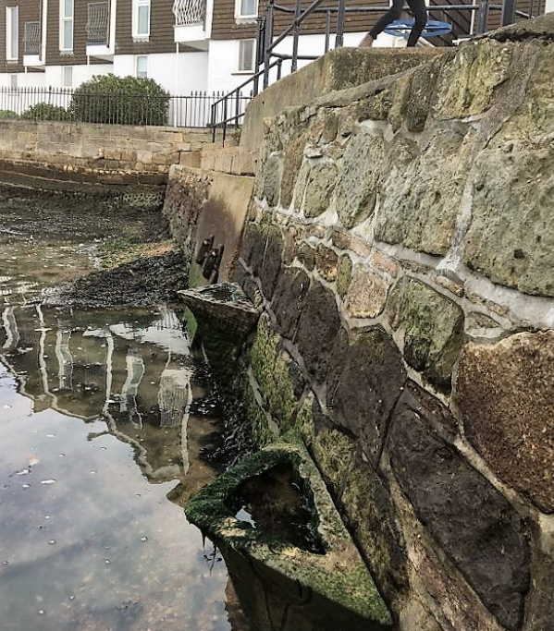
Example
Step 1 – High level objective: promote colonisation of general sealife on a seawall
Step 7 – Refined objective:
Promote colonisation of certain species of algae and limpets that thrive in intertidal environment with low wave exposure
Create water retention features because in a location nearby it was successful and can be used as a control site
Place new features at a certain level within the tidal range in an accessible location to allow for monitoring
Organise community engagement session to gather support
Notes:
Let’s look at a simple example. Let’s say in Step 1 the user set an objective of promoting colonisation of general sealife on a plain vertical seawall. Now on Step 7 that objective can be refined with some further information, for instance: the main objective is to promote colonisation of certain species of algae and limpets. To make it happen, installation of water retention features are proposed to make the most of the evidence that at a site nearby this solution was successful. And a community engagement session is planned to gather support, raise awareness and at the same time reduce the risk of vandalism.

Slide 19
Step 8 – Identifying ecological interventions
When assessing the interventions the following may be considered:
Example of Interventions
Use environmentally sensitive materials | Textured surfaces (Depressions and/or elevations ≤≤ 1mm)
Create rock pools (Retain water, depth >50mm) | Pit habitats (Depressions with a length to width ratio ≤≤ 3:1 and depth >50mm depth 1-50mm)
Create groove habitats (Depressions with a length to width ratio >3:1 and depth 1-50mm) | Create hole habitats (Do not retain water, depressions with a length to width ratio ≤≤ 3:1 and depth >50mm)
Create swim through habitats | Create crevice habitats (Depressions with a length to width ratio >3:1 and depth >50mm)
Create protrusions (Protrusion with a length to width ratio ≤ 3:1) | Create ledges or ridges (Protrusion with a length to width ratio > 3:1)
Create flexible habitats (Materials such as rope, ribbon or twine)
Intertidal Zone – Moisture and shade increased Sessile and mobile organisms. Water retention boosted the richness of Fish
Subtidal zone – Small scale depressions provides refuge that was beneficial for Sessile organisms. Elevated structures increased abundance of Fish
Taxa that responded the most positively were those with body sizes matching dimension of interventions.
A variety should be selected as different interventions enhance different groups of organisms. This helps promote more diverse ecosystems
Notes:
Step 8 Identifying Ecological interventions
Focuses on Making ecologically-based decisions about what intervention(s) are most likely to deliver the biodiversity objectives set.
When assessing the interventions the following examples are things you may want to consider as research has demonstrated that they help in creating a heterogeneous environment.
In the Intertidal Zone, moisture and shade have a positive ecological effect on Sessile and mobile organisms while water retention leads to greater richness of Fish
In the Subtidal zone, small scale depressions provides refuge from waves and predators which benefitted Sessile organisms whilst Elevated structures had a greater abundance of Fish
Different types of intervention are effective at enhancing different groups of organisms, ideally a range of approaches should be applied simultaneously to maximise niche diversity
On the right hand side there are some examples of interventions that may be used these include but are not limited to

Slide 20
Step 9 – Preliminary Specification
Decide Shape
Optimum width, depth ratio
Decide Size
Variety will increase diversity, matching body sizes to species, large sizes better for fish
Example of Installation Techniques
Drill-in (to create a depression by perforating/drilling from the surface)
Cast-in (to create a protrusion or depression when the material is still malleable, e.g. wet concrete).
Drop-in prefabricated units (to put into place prefabricated units to form part of the asset)
Cut-in (to create a cavity from the surface)
Bolt-on (to attach to the asset using bolts or anchors)
Decide Installation Techniques
Most suitable for the design and cost
Preliminary Specification
Decide Material
Texture is crucial for shoreline complexity. Sooth/hard materials not favourable
Decide how to distribute
Shore level, lower shore may deliver higher diversity.
Decide Number
Mimic natural Reefs, factoring in costs.
Notes:
Step 9 preliminary Specification
For Step 9, once the preferred type of intervention is agreed, several factors need to be considered:
You need to:
Decide the shape – an Optimum width and depth ratio is required to avoid creating traps
Decide Size – you can specifically match body sizes of target organisms and using large interventions to promote fish. It is important to note that more variety leads to increased biodiversity,
Material Choice is also important - Texture is crucial for shoreline complexity. Smooth and hard materials not favourable the best interventions create complex shapes microenvironments
You must Decide the number of interventions required– it is best to mimic local reefs, to promote local species. The deficit of different habitats type between structures and natural intertidal reefs have been quantified. This will be a useful resource for deciding how much of a specific habitat intervention would be needed to mimic natural habitats. It is currently being developed and will be added soon.
The distribution of the of the interventions must also be decided as Shore levels can also have an influence lower shore may deliver higher diversity.
Finally you must Decide installation technique – best to select a technique suitable for your structure and budget.

Slide 21
Step 10 – Existing Products
Vertipools
BIOBLOCK
Econcrete Rock pools
Intervention:
Create rock pools
Installation technique:
Bolt-on
Intervention:
Create rock pools
Create pit habitats
Create crevice habitats
Installation technique:
Drop-in prefabricated units
Intervention:
Create rock pools
Texture surfaces
Installation technique:
Drop-in prefabricated units
ECOncrete® Seawall Panels
ECOncrete® piles and jackets
Living Seawall Panels
Intervention:
Create rock pools
Create hole habitats
Create ledges or ridges
Installation technique:
Bolt-on
Intervention:
Use environmentally sensitive materials
Textured surfaces
Installation technique:
Cast-in
Intervention:
Use environmentally sensitive materials
Create rock pools
Create hole habitats
Create crevice habitats
Installation technique:
Bolt-on
Notes:
Once you know what type of solution you want to implement, you must consider if an existing off the shelf products from specialist suppliers and manufacturers suit the needs of the project or if non-specialist suppliers are more suitable. The figures shown are some off the shelf products currently available.

Slide 22
Step 11 – Feasibility assessment
Assessment of:
Contribution to meeting primary & secondary goals
Whole life cost
Carbon lifecycle assessment
Asset management and maintenance
consent , licence, permit and environmental assessment required
Health and safety requirements
Evaluate:
Other site specific challenges
Aesthetic considerations
Early stakeholder engagement
Do products and suppliers exist to deliver the intervention
Can they be installed without specialist services?
Risk of:
Attracting non native or invasive species
Displacing native species
Changing current environmental conditions
Affecting the integrity of the structure
Hindering future maintenance, repair and monitoring of the primary asset
Creating ecological traps
Notes:
After the product details are known, a feasibility assessment can be carried out. The assessment should address topics such as:
Meeting the biodiversity goals
Whole life cost
Carbon lifecycle assessment
Risk of attractive non native or invasive species
Health and safety during implementation and post construction
etc

Slide 23
Step 12 Installation and Monitoring
Establish a robust monitoring and evaluation system
Select the right time for the implementation
Iterative approach to ensure a balance of all project requirements
Example – Drill-in pits, grooves crevices
Description
Retrofitting Rock armour or concrete surfaces with habitat features.
Effectiveness: benefits assessment
Increase in species diversity compared to business as usual.
Increase in species diversity
Challenges limitations and risks
Need to ensure structural integrity remains, may require sacrificial layer of concrete
Cost
Retrofitting limestone costs (£10/m³)
Granite costs (£55/m³)
Maintenance and asset management
The size and density of the features to not negatively impact on the performance of the structure.
Timescales
Monitor control site and ecological enhancement after 6 months, 1 year, 3 years
Notes:
When it comes to installation, identifying the right time for the enhancements to be implemented is critical to its success. Enhancements should be installed to coincide with native species settlement and recruitment windows to improve the chances of success. and reduce risk of invasive species.
You must establish a robust monitoring and evaluation system that allows projects to measure success against the objectives set up as part of Step 7. For monitoring success, one or multiple control sites are required which define a baseline against which the new enhancement can be compared. Success measures can include
Extents of colonisation or percentage cover of surfaces
Number of different species, as a measure of biodiversity
Abundance of each species
Absence of Invasive and Non-Native or Invasive Species
Although the ecological enhancement selection has been outlined as a linear 12-step approach, it should be noted that an iterative approach, going back to a previous step and changing the selected option, may be required to ensure that all the project requirements (cost, buildability, ecological benefits, environmental benefits, social benefits, etc.) have been considered and balanced appropriately.
These examples are not exhaustive but provide a reference or point of discussion on the benefits and challenges that may be encountered while incorporating ecological enhancements to existing structures. The examples included are taken from several studies. The issues discussed in the following tables may or may not be all realised for other specific projects.

Slide 24
Coastal Enhancement Guidance Training Toolbox
Part 4/4 – Case Studies
(10 mins)
Notes:
We will now look at examples of techniques which can be used for ecological enhancement of coastal structures and some case studies.

Slide 25
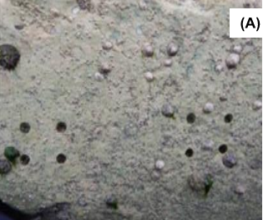
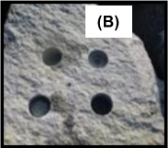
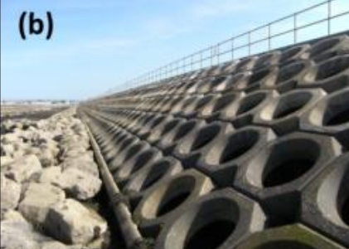
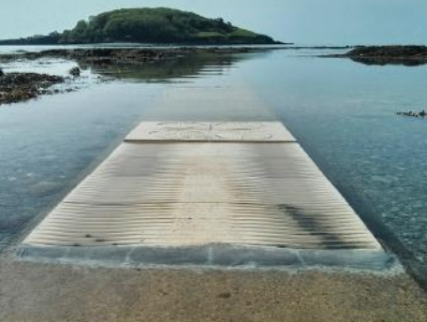
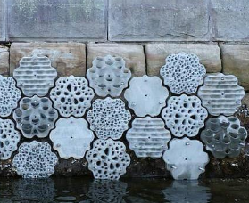
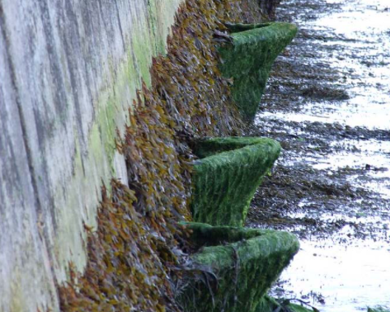
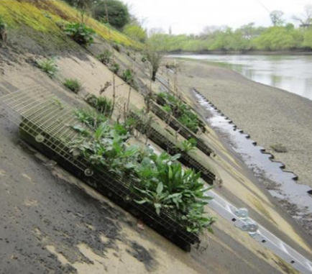
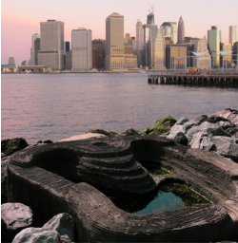
Example techniques
Technique 1
Technique 2
Technique 3
Technique 4
Drill-in Pits, grooves and crevices
Cut-in Rock pools
Cast-in Rockpools
Cast-in textured, grooved and creviced concrete
Technique 5
Technique 6
Technique 7
Technique 8
Bolt-on precast tiles/ panels
Bolt on vertical pools
Bolt on green wall modules
Drop-in Prefabricated units
Notes:
The guidance note includes examples of different techniques but what they all have in common is the intent to create some complexity in what would otherwise be a simple structure from a geometric point of view.
-No.1 Drill-in pits, grooves and crevices in rock. They provide water retaining features, refuge and secure anchor points for sea life. Something to note is the potential difference in cost of drilling depending on the type of rock.
-Cut-in and cast-in rockpools are similar to the previous example but larger in size. Between cut in and cast in, the difference is in the underlying substrate which can be natural or man made and the cast in example in the figure of Technique 3 is part of a large structure which requires a different level in terms of consenting.
-Technique no. 4 is all about the concrete mix and texture to induce marine growth. The textured features can be imprinted in precast elements for retrofitting or cast in-situ using textured formwork.
-The bolt on precast panels have complex patterns and can be attached to walls, rocks and other substrates, as their size can vary. It is important to assess how to fix the panels and also their location should consider maintenance and monitoring requirements over time.
-The vertipools in Technique 6 are particularly suitable for environments with significant tidal range where retaining water at low stages of the tide is important to improve biodiversity. Their location within the tidal range should be based on a literature review or empirical evidence and just like the precast panels, their fixings should be designed considering the exposure to waves and currents.
-Technique 7 is green wall modules which are modules filled with a suitable soil substrate and a wire mesh. They are usually deployed on steep intertidal embankment walls.
-Technique 8 is similar to the vertipools but the prefabricated units are meant to be incorporated into rip rap and rock structures such as revetments, groynes and breakwaters. The blocks can incorporate different patterns and some can even be used to fulfil a structural function, in which case their design needs to be considered from the onset of the project.
The Guidance Note provides further details including cost and implications with regards to consenting.

Slide 26
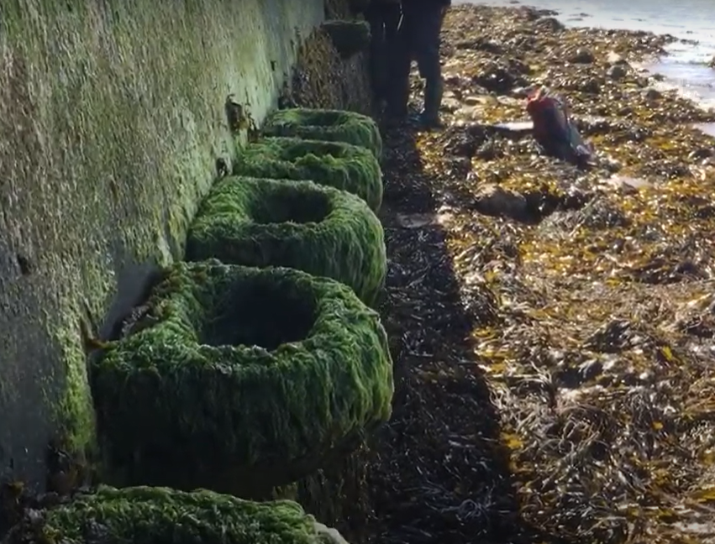
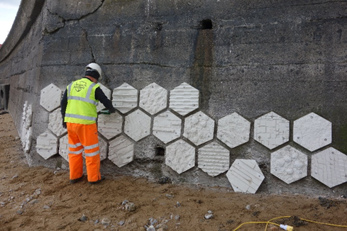
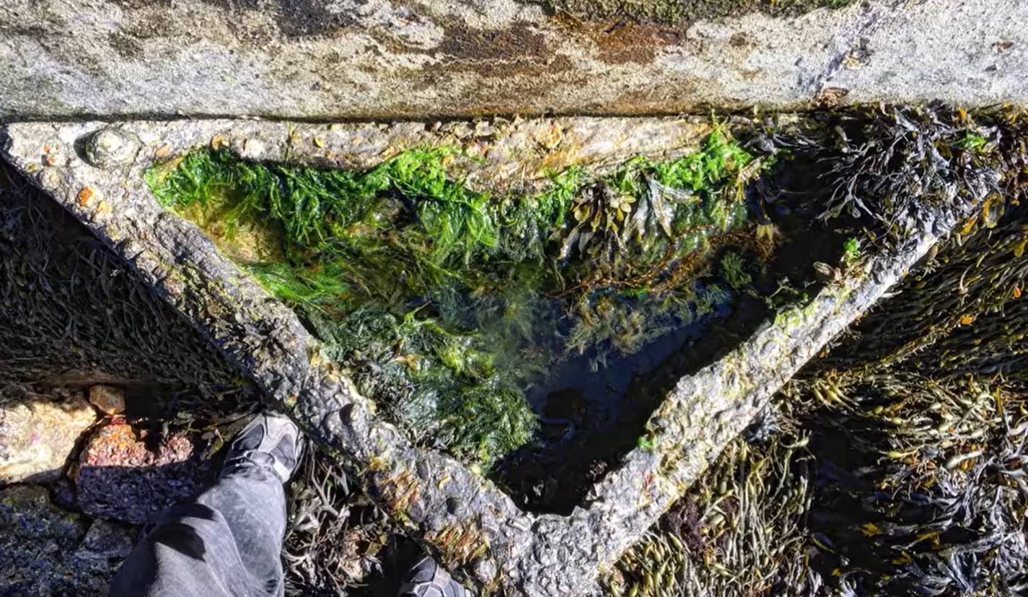
Case studies
Mumbles – Example of Technique 5
135No. hexagonal tiles were installed along the Mumbles sea defences. Each tile is around 50cm wide, and they have a variety of patterns. Preliminary results already show the differences in colonisation based on pattern, location within the tidal range and exposure to waves.
Vertipools at Bouldnor Beach, Isle of Wight – Example of Technique 6
In 2013, concrete vertipools were installed between Mean Tide Level and High Water Neaps on a concrete seawall at Bouldner, Isle of Wight. From its success in enhancing biodiversity further vertipools were added in 2020 as part of the Marineff project.
Notes:
Let’s look at some case studies
In Mumbles 135 No. hexagonal tiles were installed along the sea defences. Each tile is around 50cm wide, and they have a variety of patterns. The aim is to test which panels work best and preliminary results already show differences in colonisation based on pattern, location within the tidal range and exposure to waves.
The Vertipools at Bouldnor Beach were installed in 2013. They were installed between Mean Tide Level and High Water Neaps on a plain concrete seawall. On the original set, more than 20 species were recorded over a few years which is double the amount that were observed in the control site in the adjacent area and some of the vertipools are now completely covered in sea life. From its success in enhancing biodiversity, further vertipools were added in 2020 as part of the Marineff project.

Slide 27
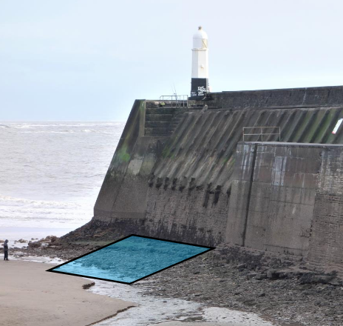
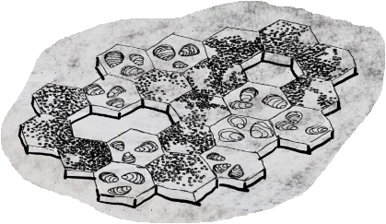
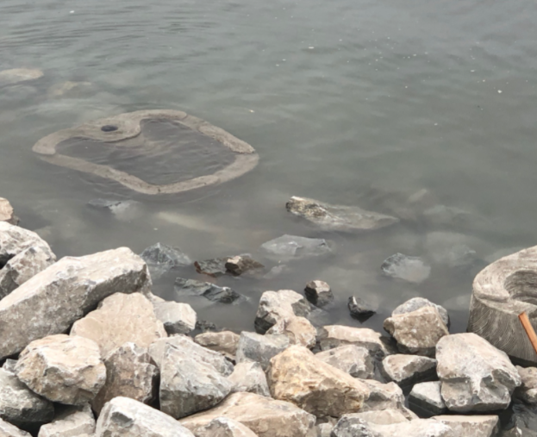
Case studies
Penrhyn Bay – Example of Technique 3
On a Coastal Risk Management Programme scheme in Penrhyn Bay, 6x no. tidal pools are proposed to be placed at different levels of the foreshore at the toe of an existing rock groyne as well as on a new rock groyne. Colonisation at different levels can inform future enhancements. The Construction is planned to be completed in late 2022 /2023.
Porthcawl – Example of Technique 2, 4
On a Flood and Coastal Erosion Risk Management scheme in Porthcawl Sandy Bay, in collaboration with CubeX, the Settlers of Porthcawl was developed. Construction is planned to be completed in 2022
Submerged pool
Emergent pool
Concept
Bio-mimics Sabellaria (reef worm) habitat
Oysters and oyster fisheries are part of Porthcawl’s natural heritage
Artificial reef will promote biodiversity
Pools formed by omission of panels
Design intent
Notes:
The Penrhyn bay case study is an example of application of tidal pools. 6x no. tidal pools are proposed to be placed at different levels of the foreshore at the toe of an existing rock groyne as well as on a new rock groyne. Colonisation at different levels of the tide will inform future enhancements elsewhere along the North coast of Wales and the Construction is planned to be completed in late 2022 / early 2023.
The Porthcawl case study is more complex and multi purpose. The enhancement is going to be built at the toe of an existing breakwater on the lee side with the main aim to Bio-mimic the Sabellaria (reef worm) habitat which is present in the area but also retain water at low tide. Contrary to the previous case study, this will be achieved by removing some tiles in the structure causing a depression.

Slide 28
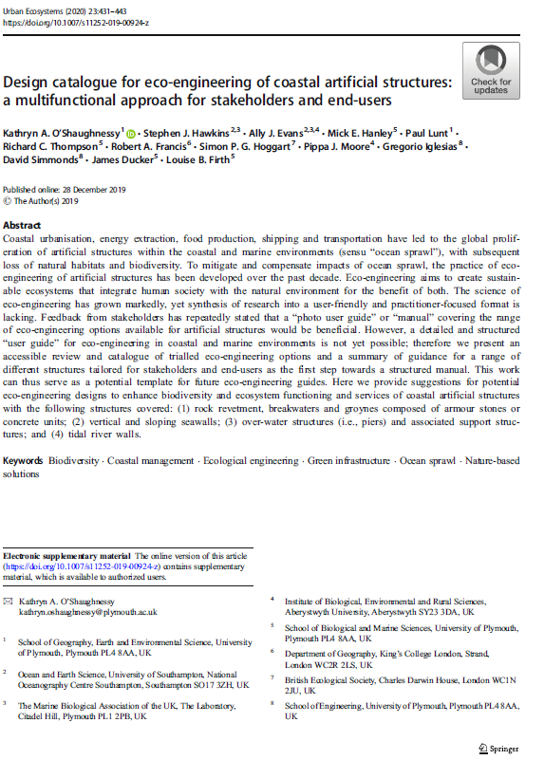
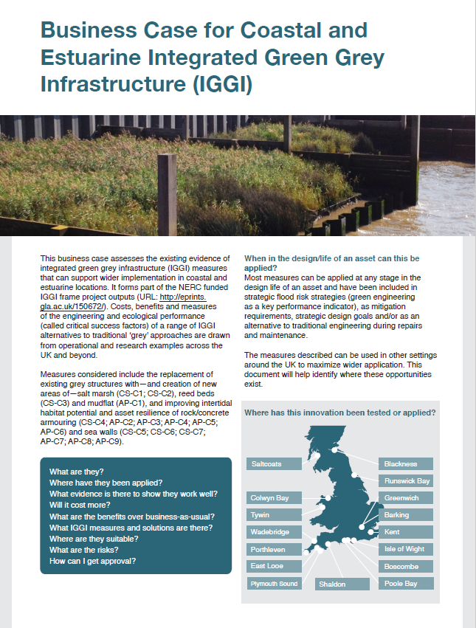
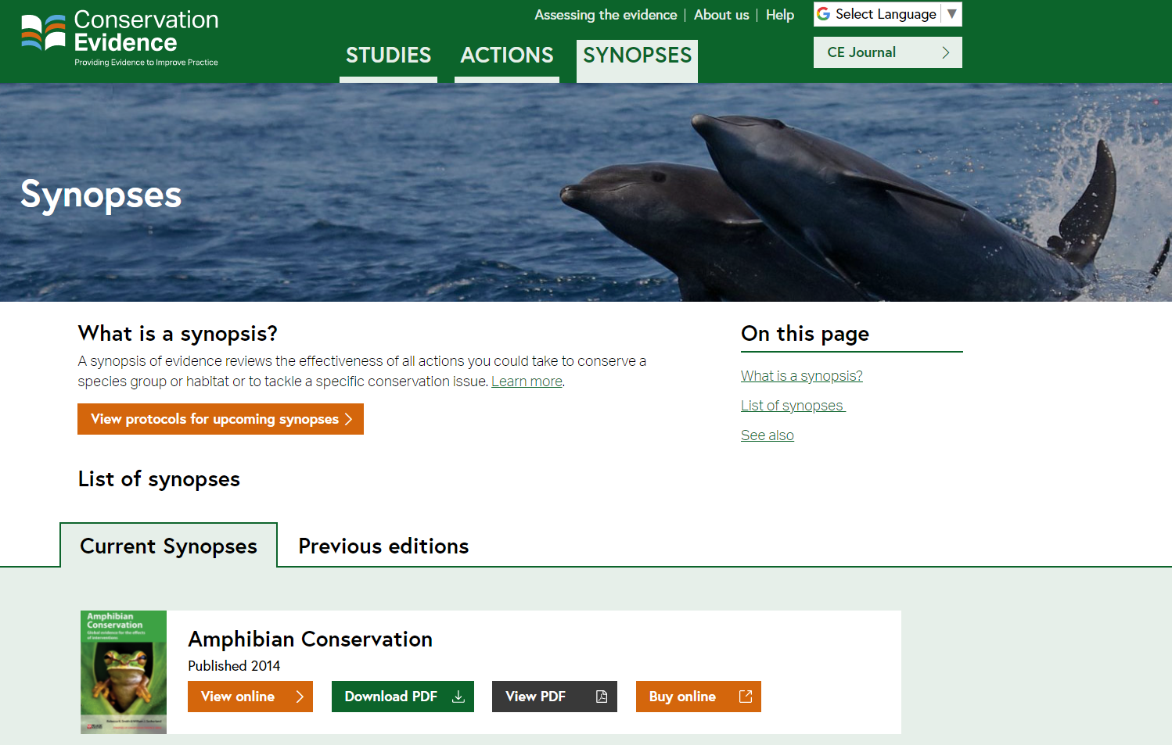
Key References
Conservation Evidence Synopsis (2021) Enhancing the Biodiversity of Marine Artificial Structures
O’Shaughnessy et al. (2020) Design catalogue for eco-engineering of coastal artificial structures: a multifunctional approach for stakeholders and end-users
Integrated Green Grey Infrastructure report (2017)
Notes:
These are the key references that have been used in this presentation, however there are many more references in the Guidance Note.
The first reference is the Conservation Evidence Synopsis entitled “Enhancing the Biodiversity of Marine Artificial Structures”. The guidance note has a dedicated section to the Synopsis. The synopsis compiles and summarizes in a systematic way published evidence of conservation interventions. This is a very useful resource and should be consulted. The Conservation Evidence website also allows you to search for specific interventions such as the ones we have been discussing, and gauge their success.
The second reference is entitled “Design catalogue for eco-engineering of coastal artificial structures: a multifunctional approach for stakeholders and end-users”. It has a review and a catalogue of trialled eco-engineering options and a summary of guidance for a range of different structures.
The Integrated Green Grey Infrastructure report presents innovations from academia and practice designed to green grey infrastructure that needs to remain primarily grey for their essential function. It has a lot of information to help better evaluate the potential benefits and limitations of using integrated green grey infrastructure measures compared to traditional grey engineering solutions.
This completes the NRW training toolkit on Ecological Enhancement of Coastal Structures. Thank you.

